Slide 1


Data Visualization with Power BI

Slide 2
Course Overview & Expectations
Welcome to the beginner's course on Power BI for Data Analytics! This course is designed to help you build a strong foundation in data visualization and reporting using Microsoft Power BI — one of the leading tools in the business intelligence space.
🧭 What You’ll Learn:
Introduction to Data Visualization
The importance of visualizing data
Best practices and design principles
Getting Started with Power BI
How to install and navigate Power BI Desktop
Overview of its key features and components
Connecting to Data Sources & Cleaning Data
Importing Excel, CSV, SQL, and web data
Using Power Query to clean and prepare data
Creating Interactive Dashboards
Designing reports using visuals
Adding slicers, filters, and tooltips
Publishing & Sharing Reports
Uploading to Power BI Service
Sharing dashboards with teams and stakeholders

Slide 3
Course Overview & Expectations
By the end of this course, you will be able to:
✅ Understand the principles of effective data visualization ✅ Use Power BI to load, clean, and visualize data ✅ Create interactive dashboards and reports ✅ Interpret and communicate insights using visuals ✅ Build your own project or portfolio dashboard
No prior experience required! This course is beginner-friendly. A basic understanding of Excel or data tables is helpful but not necessary.

Slide 4
Topic 1: Getting Started with Visualization in Power BI
What is Data Visualization?
Data Visualization is the art of turning raw data into meaningful visuals — helping users see trends, patterns, and insights that would be hard to spot in tables or text.
Imagine a spreadsheet with 10,000 rows of sales data. Hard to interpret, right? But a line chart or map can quickly show you which regions are performing well and which aren’t.

Slide 5
Topic 1: Getting Started with Visualization in Power BI
Power BI - Desktop Window
The Power BI desktop interface is a fundamental part of storytelling. It is quite resembled to MS Office. You may add ingredients to your reports to create eye-catching dashboards and reports. The different interfaces of the Power BI desktop window −
Power BI Desktop Window
The title bar at the top shows the name of the current file. The distinct tabs like File, Home, Insert, Modeling and so on will be discussed in the next part. The three icons on the middle-left side of the window show the various types of views. The middle glass shows the canvas. The right side of the window shows the different panes, like the Visualization pane and the data pane. The bottom part of the window indicates the footer.

Slide 6
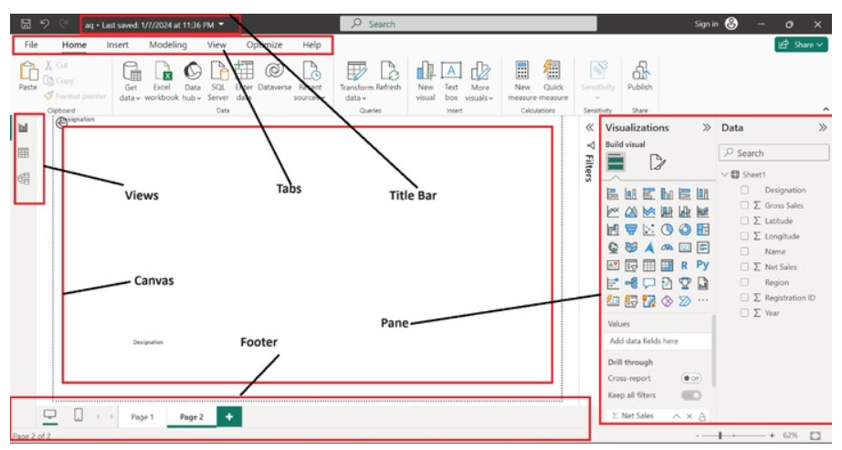
Topic 1: Getting Started with Visualization in Power BI

Slide 7
Topic 1: Getting Started with Visualization in Power BI
Power BI - Desktop Window
Types of Tabs
Here are the key types of tabs you will encounter in Power BI −
File Tab
You may open new or old files and get data from the specified location. Also, import the files from the system or export the existing files to pdf. Furthermore, you can alter the data source settings by using the "Option and setting" and broadcast and share their reports by selecting the "Publish" option.

Slide 8
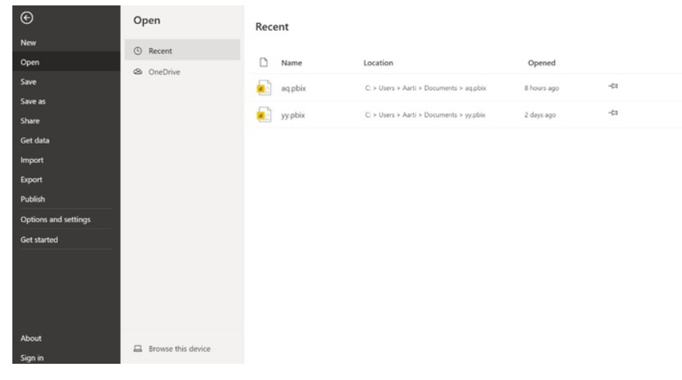
Topic 1: Getting Started with Visualization in Power BI

Slide 9
Topic 1: Getting Started with Visualization in Power BI
Home Tab
The description of its various groups is as follows −
Clipboard − It permits you to cut, copy, and paste the visual to another location.
Data − It allows you to import data from multiple sources. You may import the Excel workbook by choosing the "Excel Workbook" option instantly. Data hubs are seamlessly used in Power BI service. You may develop the live connection to semantic models, data marts, Warehouses, and Lakehouse and use authentic data in the Power BI service.
Queries − It uses a Power Query editor that acts as a backend. You may rectify the data anomalies and connect and cleanse the data by choosing the "Transform data" option.
Insert − You can add new ingredients to the report by utilizing the "Insert" group that can add new visuals, and textbox and import custom visuals directly either from the Appstore or the local system.
Calculations − New measure" where DAX expressions are written and use "Quick measure" to develop complicated calculations.
Sensitivity −
Share − You may broadcast the report in the Power BI service.

Slide 10
Topic 1: Getting Started with Visualization in Power BI

Slide 11
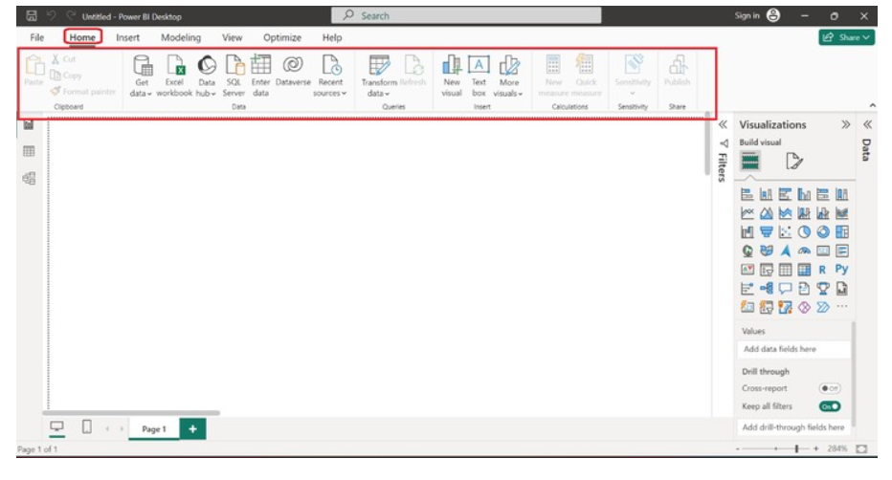
Topic 1: Getting Started with Visualization in Power BI

Slide 12
Topic 1: Getting Started with Visualization in Power BI

Slide 13
Topic 1: Getting Started with Visualization in Power BI
Insert Tab
The extensive information related to the Insert tab's groups is as follows −
Pages − You can add new pages either blank or duplicate pages into the report by using the Pages group.
Visuals − You may utilize the Visuals group to add new visuals or more visuals from appsource or my files to the report to make interactive reports.
AI visuals − Natural languages are used by AI visual groups, and metric influencers are added to the report by choosing key influences, a decomposition tree indicates how data is represented hierarchically, and narrative generates intelligent summaries of data automatically.
Power Platform − This group is used to integrate paginated reports, Power Automate to automate complex tasks and Power apps.
Elements − You can add distinct elements like Text boxes, Buttons, Shapes, and Images to the report.
Sparklines − You can embed a sparkline (small chart) in either a matrix or table visuals.

Slide 14
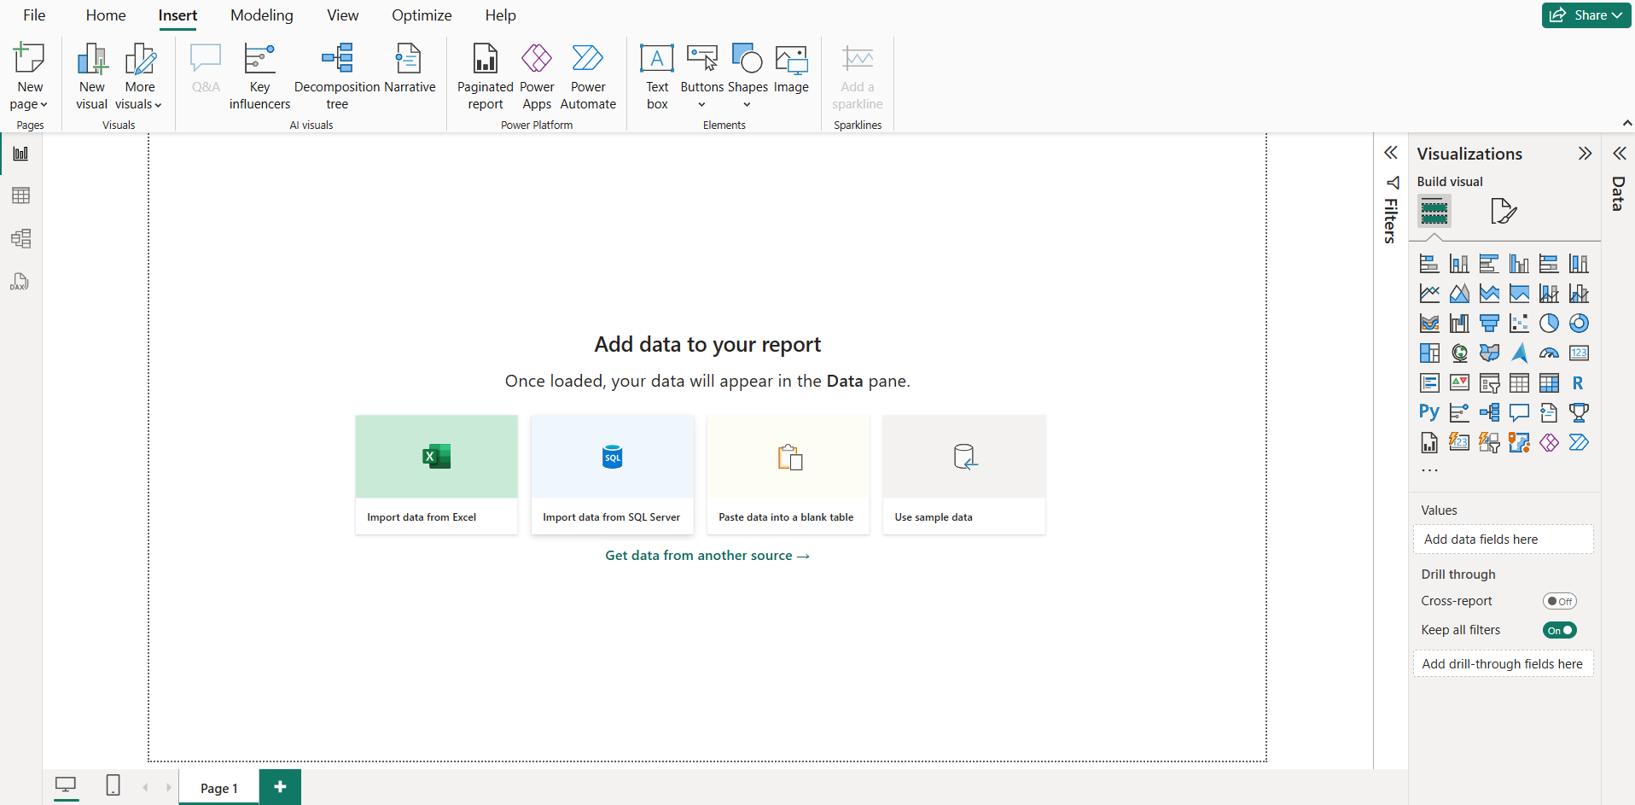
Topic 1: Getting Started with Visualization in Power BI

Slide 15
Topic 1: Getting Started with Visualization in Power BI
Modeling Tab
The description of various groups residing in Modeling tab is described below −
Relationships − You may choose the "Manage relationships" option if you wish to append, alter, or delete relationships among tables.
Calculations − You can employ DAX expressions to generate new tables and new columns, and new measures can be developed through this calculation group.
Page Refresh − It permits you to refresh pages relying on identifying changes in the dataset to enhance the performance of the report.
Parameters − We may add parameters to the visuals and also use slicers to adjust the inputs and predict the output.
Security − Managers and higher-level authority use the "Security" option to ensure the row level of security.
Q&A − You may use this group to understand the dataset and alter the language utilized to ask questions to know more about terms and data.

Slide 16
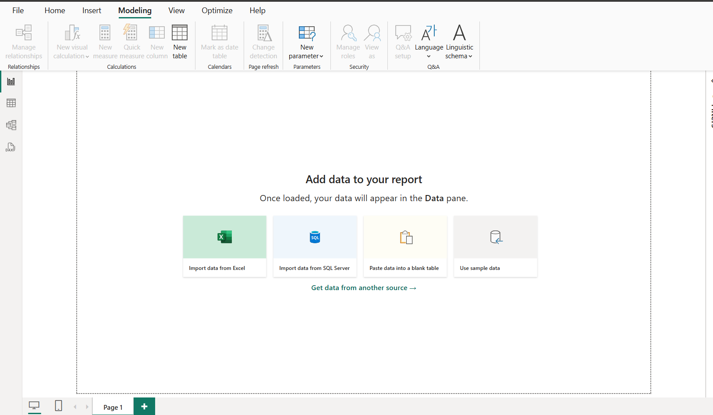
Topic 1: Getting Started with Visualization in Power BI

Slide 17
Topic 1: Getting Started with Visualization in Power BI
View Tab
The description of its various groups is written below −
Themes − You can create a theme, change the default theme of the report, and customize the present theme for stunning reports.
Scale to fit − Depending on your needs, you can choose from alternatives like "fit to width," "fit to page," and "actual size" of the page.
Mobile − You may also create a report for mobile phones.
Page options − You can automatically or manually align the objects either by selecting the "Snap to grid" option or "Gridline" option and also lock objects while showcasing the presentation.
Show Panes − The filter pane can either be visible or hidden by using the filter option. Bookmarks can be added or viewed to capture the data.

Slide 18
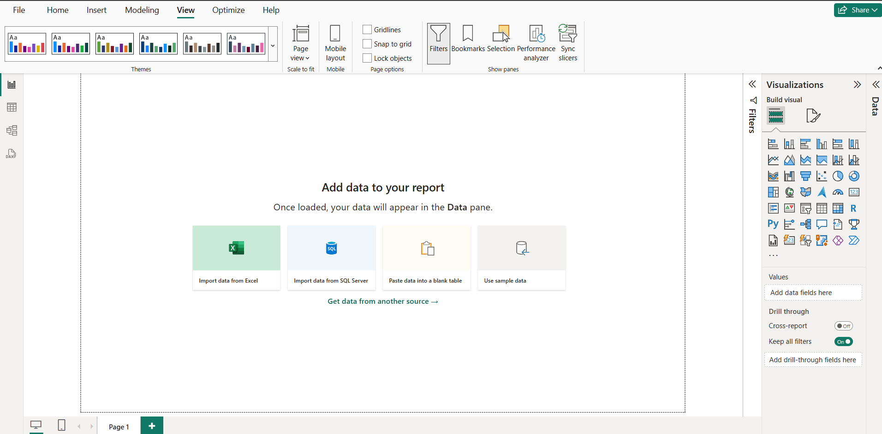
Topic 1: Getting Started with Visualization in Power BI

Slide 19
Topic 1: Getting Started with Visualization in Power BI
Help Tab
Each tab has a different group, and the following are the groups in the Help tab −
Info − This group assists users in knowing the version of downloaded Power BI tools and acquiring the session information while submitting a ticket.
Help − You may take help from the training videos, support, and documentation to learn more about Power BI.
Community − You may join the Power BI community to collaborate with other experts and read the blog, get to know the recent updates of the tools, and also download the external tools that are compatible with Power BI.
Resources − You may explore examples and workshops provided by the consulting service to enhance your skills.

Slide 20
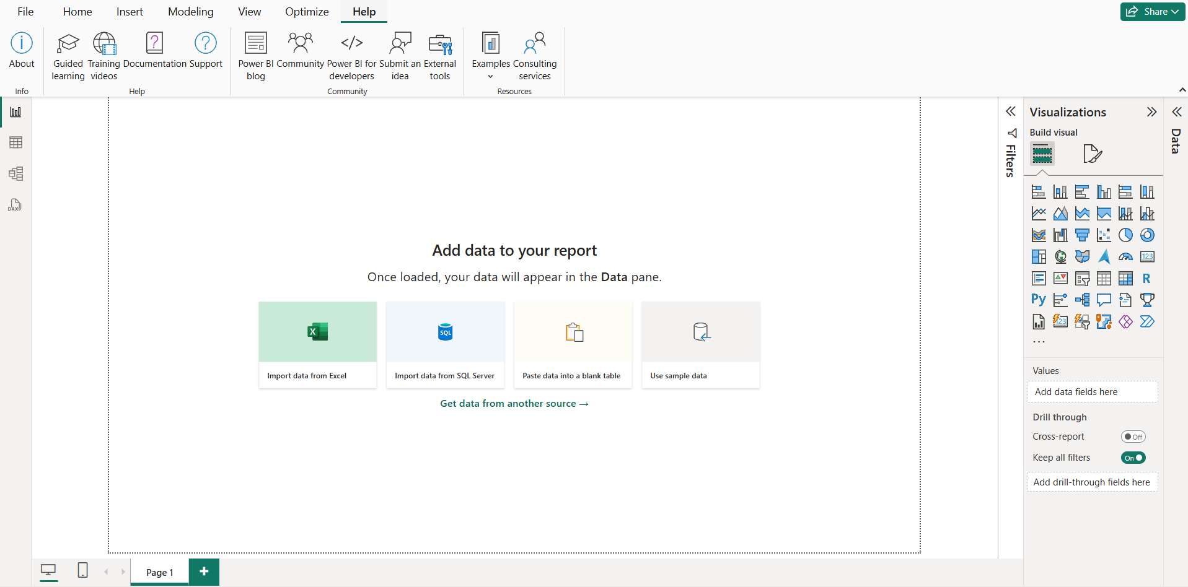
Topic 1: Getting Started with Visualization in Power BI

Slide 21
Topic 1: Getting Started with Visualization in Power BI
Power BI - Supported Data Sources
Power BI supports a large range of data sources. You can click Get data and it shows you all the available data connections. It allows you to connect to different flat files, SQL databases, and Azure cloud or even web platforms such as Facebook, Google Analytics, and Salesforce objects. It also includes an ODBC connection to connect to other ODBC data sources, which are not listed.
The reports developed in this tool require authenticated datasets which ensures the visualizations of the report. Invalid datasets can't load into the Power BI tool. When you are publishing the report to the Power BI service, datasets will also be broadcasted.
Following are the available data sources in Power BI −
Flat Files
SQL Database
Azure Cloud platform
Online Services
Other data sources such as Hadoop, Exchange, or Active Directory

Slide 22
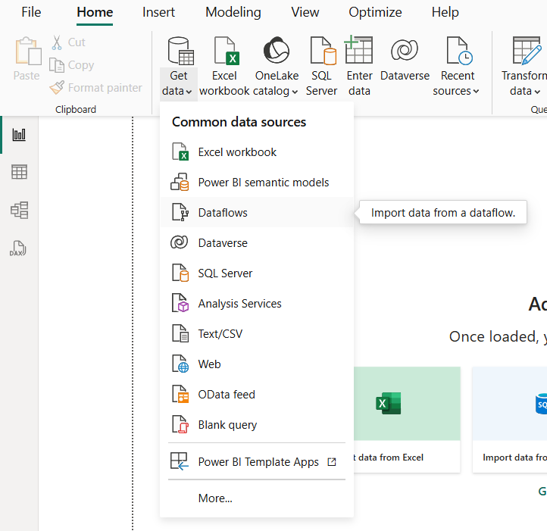
Topic 1: Getting Started with Visualization in Power BI
For more info: https://www.tutorialspoint.com/power_bi/power_bi_supported_data_sources.htm

Slide 23
Topic 2: Power BI: Power Query Editor
Power BI - Supported Data Sources
Power Query Editor is a special ingredient of Power BI Desktop that is used to profile, refine, and clean the data. You may apply certain constraints to identify errors and rectify them to create a new dataset.
Need for a Power Query Editor
If you are playing with large datasets and creating reports directly after loading the datasets, you will develop an inaccurate report that is of no use. Large datasets contain lots of errors, like incorrect values, null values, ambiguous values, duplicate columns, etc. The Power Query Editor is a component where you identify the impurities in your dataset and eliminate all anomalies to reshape the dataset.
Various Options to Transform Data in Power Query Editor
There are various ways to transform data. First, navigate to the Home tab and select the required options like Split column, Group by, Replace Value, and Alter data type of the selected column from the "Transform" group. Another way is to select the Transform tab where numerous options are categorized into various groups. The manage column is a group where you can remove duplicate columns.

Slide 24
Topic 2: Power BI: Power Query Editor
Power Query Editor
Various Options to Transform Data in Power Query Editor
Any Column Group
You can identify the data type of the selected column and can change its data type to your needs.
You may also change the name of the specified column.
You can replace incorrect and error values with correct values. Another way is to interchange the present value with the new values in any column.
Eliminate duplicate values and empty values and fill empty values.
Select the "Pivot column" to create new columns using the names in the currently chosen column.
Choose the "Unpivot column" to develop the Attribute-Value pair for the selected/unselected column.
Convert the specified column into a list.
Consolidate rows in the dataset depending on the values in the specified column.
Alter the invalid data types of columns to the correct data type.

Slide 25
Topic 2: Power BI: Power Query Editor
Various Options to Transform Data in Power Query Editor… Cont…
Text Columns Group
Select the "Split column" tile embedded in the Text column group under the Transform tab. You may Split the Column by a delimiter, by position, by the number of characters, by uppercase to lowercase and lowercase to uppercase, digit to non-digit and vice versa, etc.
You can choose the Format tile to convert the text either into lowercase or uppercase, eliminating the whitespaces from the column s field value, and deleting nonprintable characters in the column.
Select "Parse" to retrieve JSON/ XML data into table form..
Date & Time Column Group
Alter data and time values to the valid dates in the Date/Time columns.
Consolidate data and time values from defined columns into new columns.
You may also format duration values.

Slide 26
Topic 2: Power BI: Power Query Editor
Various Options to Transform Data in Power Query Editor… Cont…
Number Column Group
You can conduct the statistical operation for the descriptive analysis of numeric data by selecting the "Statistics" tile.
The fundamental arithmetic operations like Modulo, Percentages of, Addition, multiplication, and Subtraction are also performed by choosing the "Standard" tile.
You can also conduct Scientific operations like Factorial, Logarithmic, Exponent, Power, square root, etc by choosing the "Scientific" tile.
The basic trigonometric functions like Arctangent, Sine, Cosine, Tangent, and so on are also performed in the column s value.
You may perform rounding of large decimal numbers through options like round down, round up, and round.
You can alter the column s field value into even or odd according to the field sign value.

Slide 27
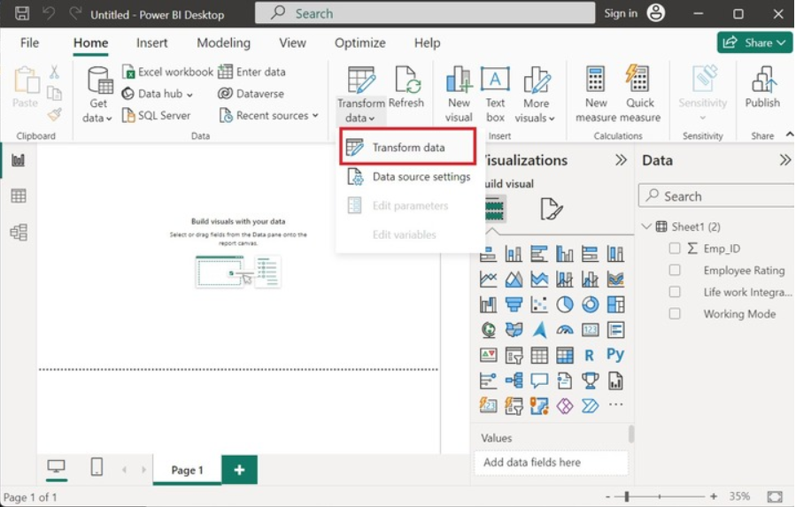
Topic 2: Power BI: Power Query Editor
Major Steps to Transform Data into Power Query Editor
Once you load the data into Power BI and click on the "Transform data" from the Queries group.

Slide 28
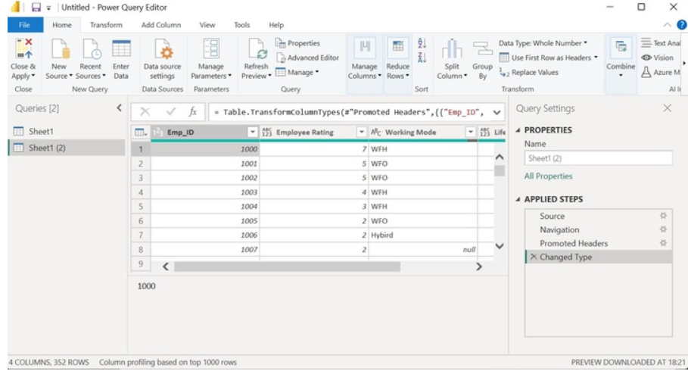
Topic 2: Power BI: Power Query Editor
The Power Query Editor window will open where you can transform the loaded data. The third column "Working Mode" has so many null values..

Slide 29
Topic 2: Power BI: Power Query Editor
The Power Query Editor window will open where you can transform the loaded data. The third column "Working Mode" has so many null values..

Slide 30
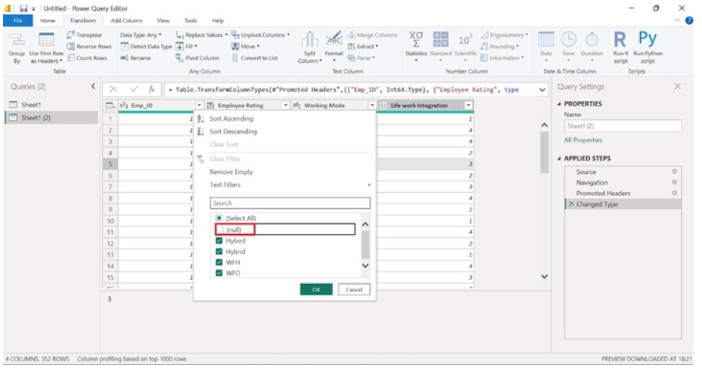
Topic 2: Power BI: Power Query Editor
Click on the "Working Mode" ▼ untick the "null" values and click OK.
The null values were deleted from the selected column and the new dataset is generated that contains no empty values. More : https://www.tutorialspoint.com/power_bi/power_query_editor_introduction.htm

Slide 31
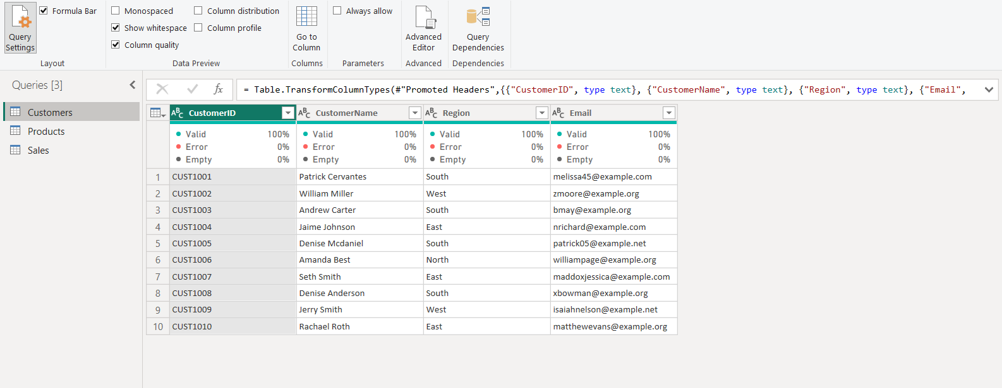
Topic 2: Power BI: Power Query Editor
Data Discrepancy and Reshaping Data
Case Study 1
The first time, when you loaded and transformed the dataset into Power Query Editor, you’d wish to see the quality of the sample dataset. To achieve this, you navigate to the View tab and click on "Column Quality" in the "Data Preview group".

Slide 32
Topic 2: Power BI: Power Query Editor
Data Discrepancy and Reshaping Data
Now, you monitor the quality of every column. The first column CustomerID is valid as there is no Error and no empty data value.

Slide 33
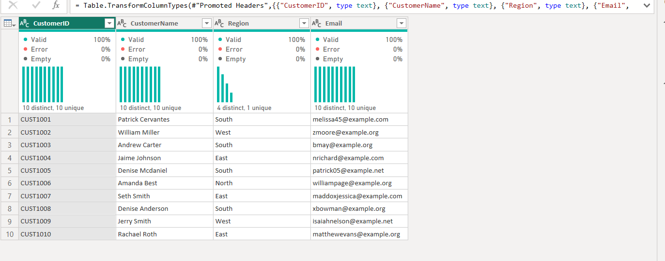
Topic 2: Power BI: Power Query Editor
Column Distribution
In Power BI's Power Query Editor, the Column Distribution feature helps you quickly understand how values are spread across each column — especially useful for categorical data.
When you enable this option from the View tab, Power BI shows a small bar chart beneath each column, displaying the number of distinct and unique values.
In our dataset:
CustomerID has 10 distinct and 10 unique values — each ID is unique.
Customer Name also has 10 distinct and 10 unique values — no name is repeated.
Region has 4 distinct values — some regions are repeated.
Email has 10 distinct and 10 unique values — every email is different.

Slide 34
Topic 2: Power BI: Power Query Editor
Column Profile
When working with data in Power BI, we often need to explore detailed statistics for each column. To do this, we can use the Column Profile feature found in the Data Preview section of the Power Query Editor.
By enabling Column Profile from the View tab, we can see a comprehensive summary of each selected column.
For example, if we select the CustomerID column, Power BI displays statistics such as the total number of rows, count of empty or error values, minimum and maximum values, and even the standard deviation and average (for numeric fields).For non-numeric fields like Customer Name, Region, and Email, we can still view important information such as the number of distinct and unique values, empty records, and a frequency distribution of the most common values.
This feature allows us to better understand our data, spot errors, and make informed decisions during the data cleaning process.

Slide 35
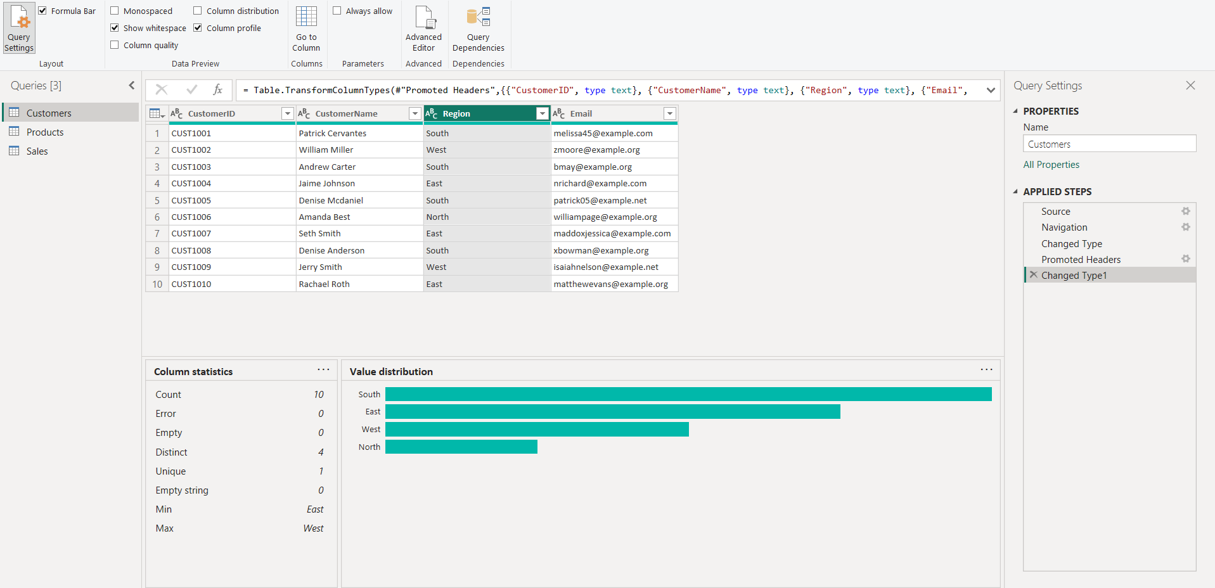
Topic 2: Power BI: Power Query Editor

Slide 36
Topic 2: Power BI: Power Query Editor
Change Column Data Type
In Power BI, we can change the data type of a column to match the kind of data it holds. To do this, we first click on the column header — for example, CustomerID — then go to the Transform tab in the Power Query Editor. From there, we can select the appropriate data type, such as Whole Number, Text, or Fixed Decimal Number, depending on the column's content.
For instance, since CustomerID is a numeric identifier, we might change its type to Whole Number. On the other hand, columns like Customer Name, Region, and Email should be set to the Text data type because they contain alphabetic or mixed characters.
Choosing the correct data type is important for accurate analysis and ensures Power BI handles your data correctly in calculations, filtering, and visualizations.

Slide 37
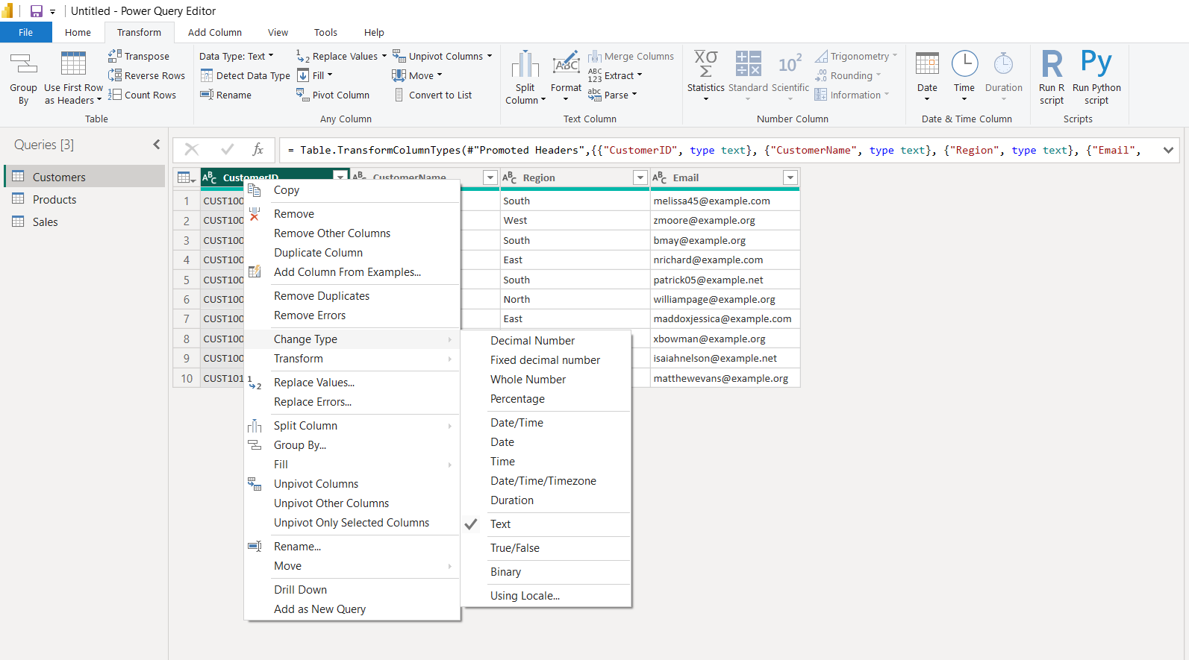
Topic 2: Power BI: Power Query Editor

Slide 38
Topic 2: Power BI: Data Modelling
Introduction to Data Modeling
In real-world data analysis, we often deal with data from different sources — like a customer database, a product list, and a table of sales transactions. These data tables are usually connected by common identifiers (such as CustomerID or ProductID).Data Modeling in Power BI allows us to define these connections — known as relationships — so that we can analyze and visualize data across multiple tables as if it were all in one.For example, we don’t have the product name in the Sales table. But through modeling, we can relate the Sales and Products tables using ProductID, and Power BI can pull the product name into reports without duplicating data. We are going to use 3 dataset:
Sales
Customers
Products

Slide 39
Topic 2: Power BI: Data Modelling
Introduction to Data Modeling
In real-world data analysis, we often deal with data from different sources — like a customer database, a product list, and a table of sales transactions. These data tables are usually connected by common identifiers (such as CustomerID or ProductID).Data Modeling in Power BI allows us to define these connections — known as relationships — so that we can analyze and visualize data across multiple tables as if it were all in one.For example, we don’t have the product name in the Sales table. But through modeling, we can relate the Sales and Products tables using ProductID, and Power BI can pull the product name into reports without duplicating data. We are going to use 3 dataset:
Sales
Customers
Products

Slide 40
Topic 2: Power BI: Data Modelling
Creating Relationships in Power BI
To perform cross-table analysis (e.g., total sales by product name or customer region), we must create relationships between these tables.
🔧 Steps to Create a Relationship
Load All Three Tables:
In Power BI Desktop, use the Get Data option to import the three Excel tables.
After loading, go to the Model View by clicking on the Model icon on the left sidebar.
Linking Tables:
Click and drag CustomerID from the Sales table to the CustomerID in the Customers table.
Do the same for ProductID in the Sales table to ProductID in the Products table.
Power BI automatically detects the relationship type. For both cases, it should show:
Cardinality: Many to One (*:1)
Cross filter direction: Single
🧠 Why this matters: Now that the Sales table is connected to Customers and Products, you can pull fields like CustomerName and ProductName directly into your visualizations — even though those columns don’t exist in the Sales table.

Slide 41
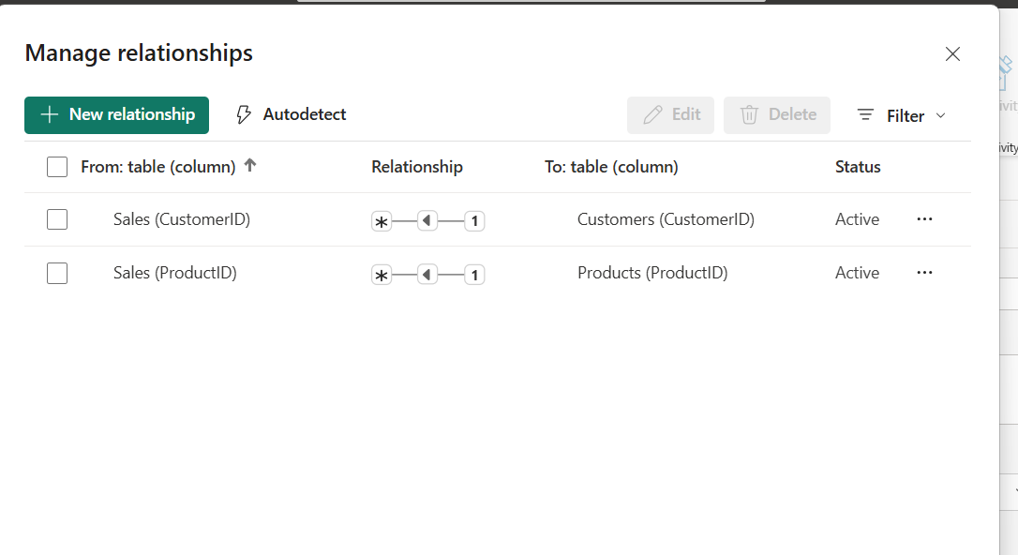
Topic 2: Power BI: Data Modelling

Slide 42
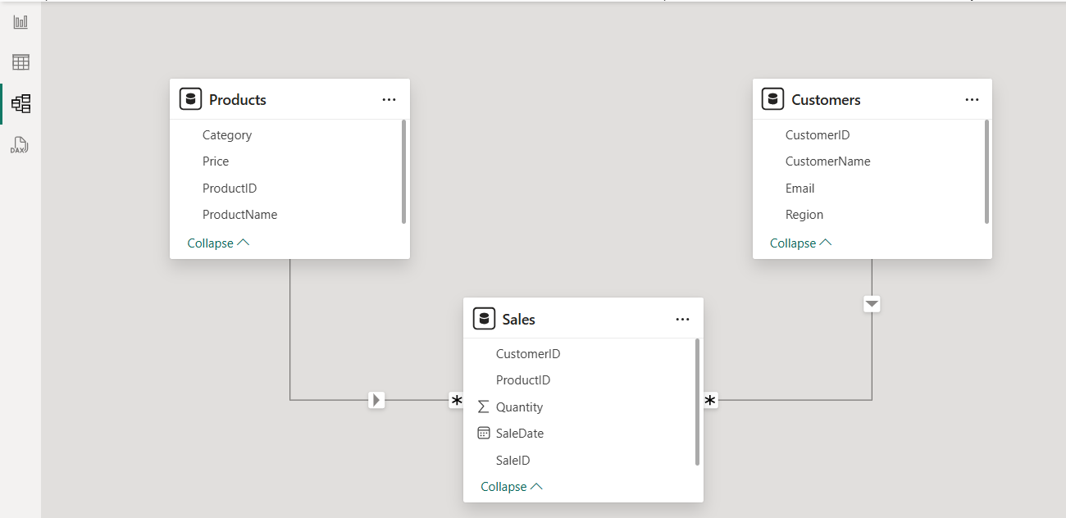
Topic 2: Power BI: Data Modelling

Slide 43
Topic 2: Power BI: Data Modelling
Creating Calculated Fields in Power BI
In Power BI, calculated fields (also called calculated columns or measures) are custom fields you create by applying formulas to your existing data. They allow you to perform computations, combine data, and generate new insights without changing the original dataset.
Calculated fields are essential tools in Data Modeling because they help you:
Add new data points based on existing columns.
Build relationships between tables.
Create meaningful metrics that reflect your business logic.
Simplify complex calculations for use in reports and dashboards.
What Are Calculated Columns vs. Measures?
Calculated Columns: These are new columns added to your data tables. They are calculated row by row and stored in the table. You use calculated columns when you want to create new data points at the row level, like combining or transforming existing columns.
Measures: These perform calculations on aggregated data, like sums, averages, or counts, calculated on the fly based on filters or slicers in your report. Measures are often used for KPIs and summary metrics.

Slide 44
Topic 2: Power BI: Data Modelling
How to Create a Calculated Column
Switch to the Data View in Power BI Desktop (table icon on the left).
Select the table where you want to add the new column.
Go to the Modeling tab in the top ribbon.
Click New Column.
Enter a DAX formula that defines the calculation you want.
Example: To create a Total Sales column by multiplying Quantity by Price (assuming a relationship exists between the Sales and Products tables):
Total Sales = Sales[Quantity] * RELATED(Products[Price])

Slide 45
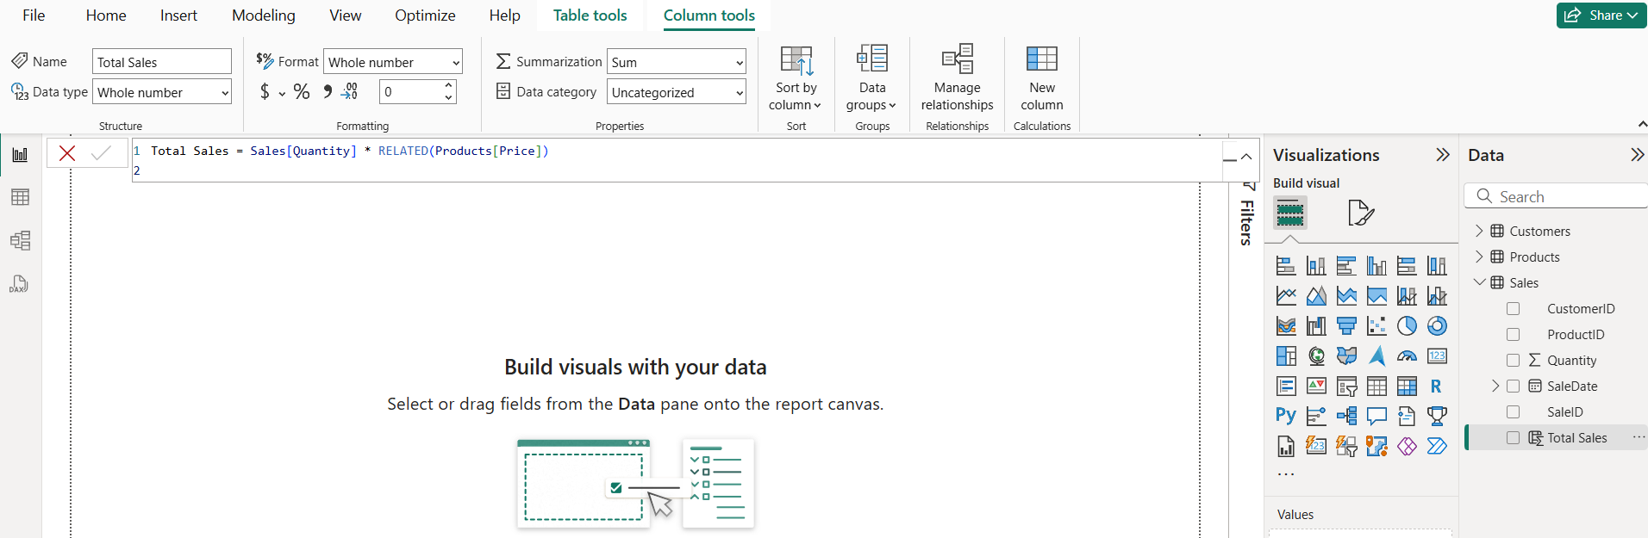
Topic 2: Power BI: Data Modelling

Slide 46
Topic 2: Power BI: Data Modelling
Creating Calculated Tables
In Power BI, calculated tables allow you to create new tables derived from your existing data tables. These tables are defined by DAX formulas and can be used to summarize, filter, or reshape data in ways that are not directly available from your original datasets.
Calculated tables are useful when you want to focus on specific subsets of data or combine information from multiple tables into a new table for easier analysis.
How to create a calculated table:
Navigate to the Data View by clicking the table icon on the left side of Power BI.
Click on the Modeling tab on the top ribbon.
Select New Table.
Enter a DAX formula that defines the new table.

Slide 47
Topic 2: Power BI: Data Modelling
Example:
Products That Have Been Sold
Imagine you want a table that only includes products which have been sold at least once. This can help you analyze active products without clutter from products with no sales.
You can create this table using the following formula:
Products_Sold =
FILTER(
Products,
Products[ProductID] IN VALUES(Sales[ProductID])
)

Slide 48
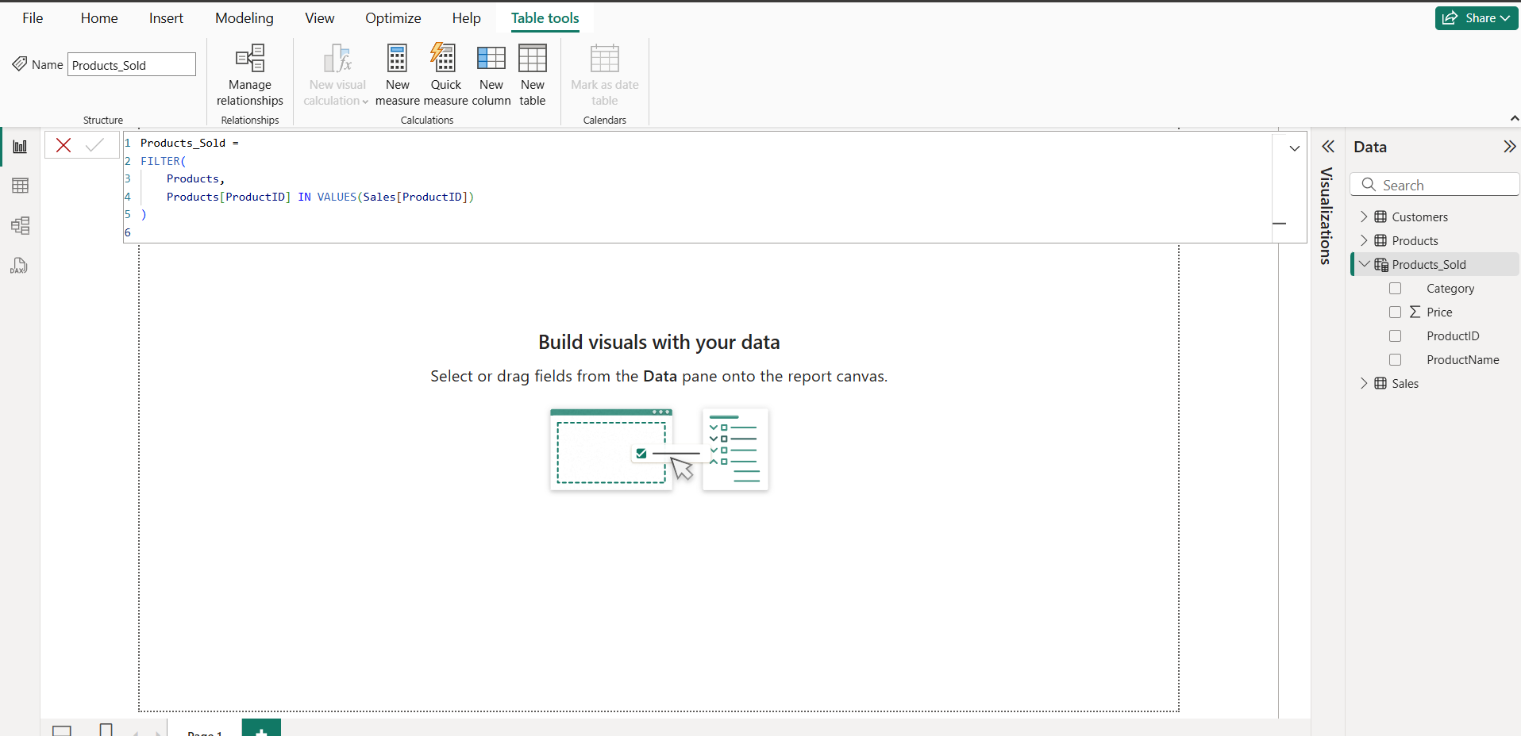
Topic 2: Power BI: Data Modelling

Slide 49
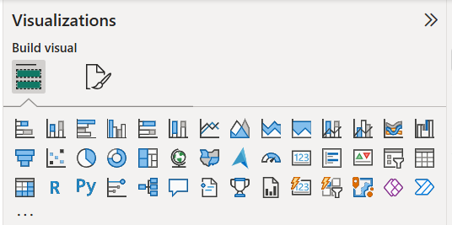
Topic 3: Power BI: Visualizations
Creating Simple Visualizations
Visualizations are used to effectively present your data and are the basic building blocks of any Business Intelligence tool. Power BI contains various default data visualization components that include simple bar charts, pie charts maps, and also complex models such as waterfalls, funnels, gauges, and many other components.

Slide 50
Topic 3: Power BI: Visualizations
In Power BI, you can create visualization in two ways. The first is by adding from the right side pane to Report Canvas. By default, it is the table-type visualization, which is selected in Power BI. Another way is to drag the fields from the right side bar to the axis and value axis under Visualization. You can add multiple fields to each axis as per the requirement.
In Power BI, it is also possible to move your visualization on the reporting canvas by clicking and then dragging it. You can also switch between different types of charts and visualizations from the Visualization pane. Power BI attempts to convert your selected fields to the new visual type as closely as possible.

Slide 51
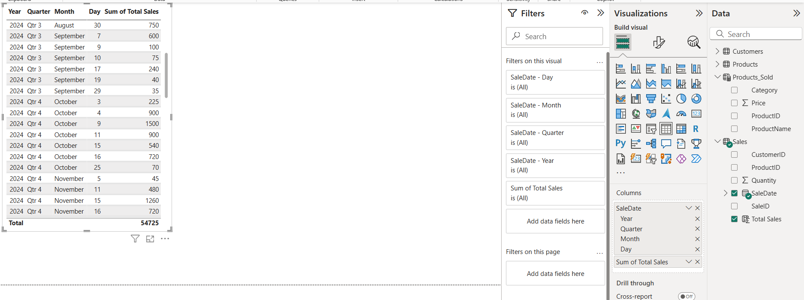
Topic 3: Power BI: Visualizations

Slide 52
Topic 3: Power BI: Visualizations
Creating Map Visualizations
In Power BI, we have two types of map visualization - bubble maps and shape maps. If you want to create a bubble map, select the map option from the visualization pane.
To use a bubble map, drag the map from Visualizations to the Report Canvas. To display values, you have to add any location object to the axis.
In the value fields, you can see that it accepts values axis such as City and State and or you can also add longitude and latitude values. To change the bubble size, you need to add a field to the value axis.
You can also use a filled map in data visualization, just by dragging the filled map to the Report Canvas.
Note − If you see a warning symbol on top of your map visualization, it means that you need to add more locations to your map chart.

Slide 53
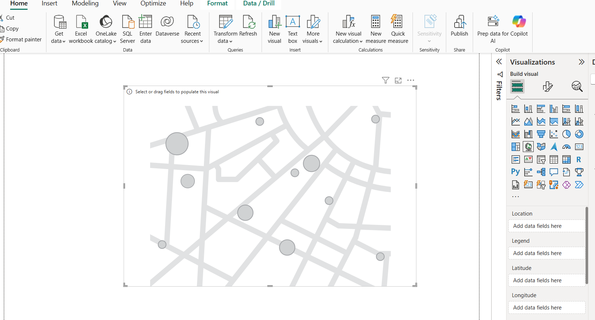
Topic 3: Power BI: Visualizations

Slide 54
Topic 3: Power BI: Visualizations
Modify Colors in Charts
In Power BI, you can also modify the colors in the chart. When you select any visualization, it has an option to change the color. The following options are available under the Format tab −
Legend
Data Colors
Detail Label
Title
Background
Lock Aspect
Border
General
To open these options, go to the Format tab as shown in the following screenshot. Once you click, you can see all the options available.

Slide 55
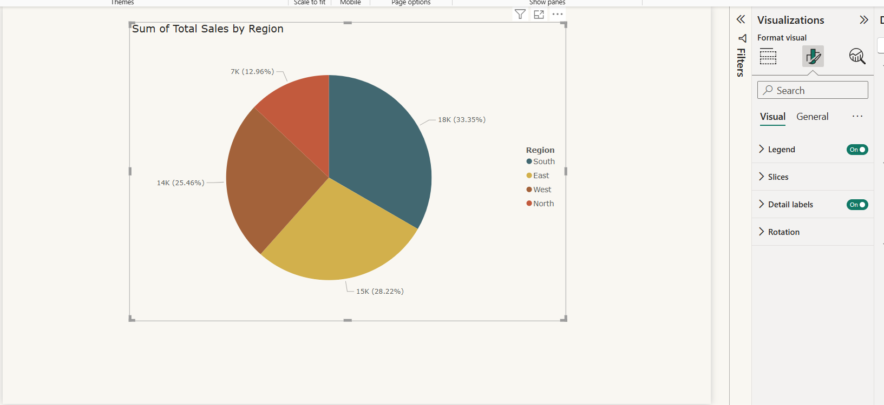
Topic 3: Power BI: Visualizations

Slide 56
Topic 3: Power BI: Visualizations
Adding Shapes, Images, and Text box
Sometimes it is required that you need to add static text, images, or shapes to your visualization. In case you want to add a header/footer any static signatures, or messages to data visualization this option can be used.
You can also add URLs in the text box and Power BI uses those links to make it live.
To add shapes, images, and text boxes, navigate to the Home tab, and at the top you will find an option to add images.

Slide 57
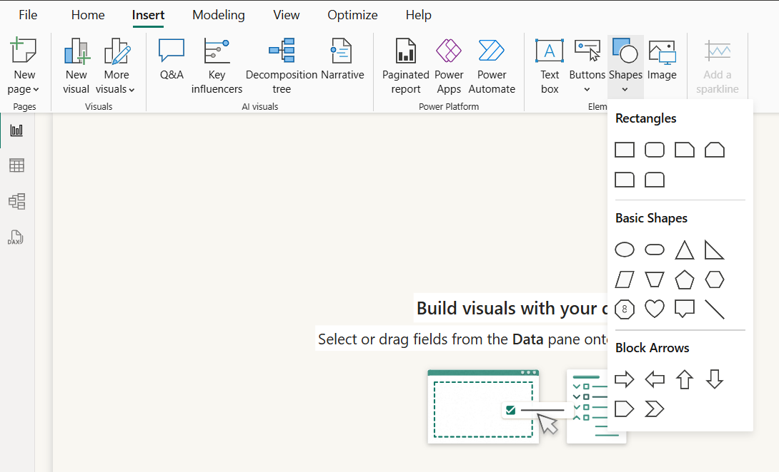
Topic 3: Power BI: Visualizations

Slide 58
Topic 3: Power BI: Visualizations
You can insert different shapes in data visualization. To see the available shapes, click the arrow next to the Shapes button.

Slide 59
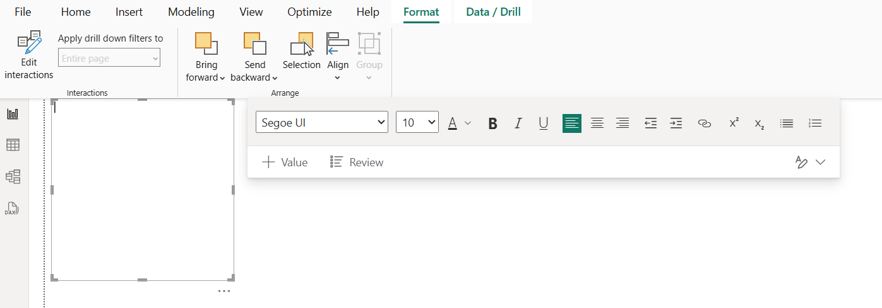
Topic 3: Power BI: Visualizations
When you click on the text box, it adds a text box in your Report canvas. You can enter any text in the text box and use the rich text editor to make formatting changes.

Slide 60
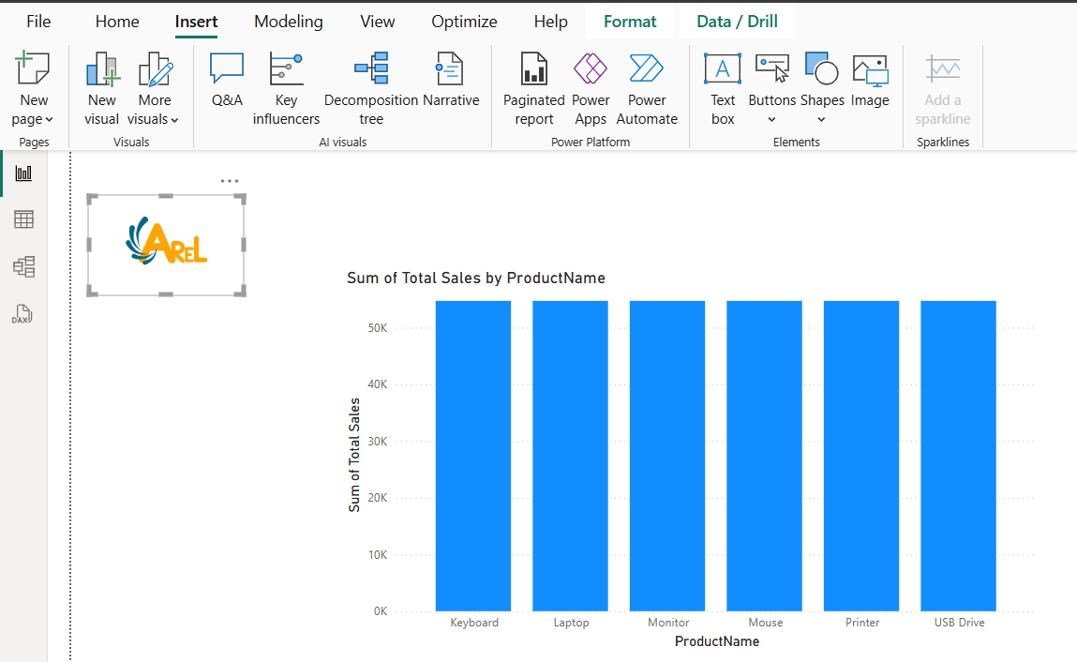
Topic 3: Power BI: Visualizations
Similarly, images can be added to data visualization to add logos or other images to data visualization. When you click the Image option, it asks for a path to pass the image file.
You can add shapes by selecting any shape from the dropdown list. You can also resize it using different options

Slide 61
Topic 3: Power BI: Visualizations
Types of Visuals in BI Desktop
Here are the common types of visuals available in Power BI Desktop −
Stacked Bar Chart
A 2D horizontal stacked rectangle with no overlaps is employed for depicting the data values in a stacked bar chart.
Stacked Column chart
A 2D vertical stacked rectangle with no interruptions will be utilized to show the data values in a stacked column chart.
Clustered bar chart and Clustered Column chart
A cluster bar chart is used to visualize large voluminous of data with extended labels. In the clustered column chart, the different data points are illustrated by various vertical bars depending on the supported fields.
100% Stacked bar chart and 100% Stacked column chart
These charts are employed to combine the data values and the percentages of different data values are illustrated through multiple horizontal bars/multiple vertical bars that exhibit 100% length on each bar.

Slide 62
Topic 3: Power BI: Visualizations
Types of Visuals in BI Desktop
Here are the common types of visuals available in Power BI Desktop −
Line chart
The line chart discloses the patterns that vary over certain periods. For example, tracking the monthly sales production.
Area chart and Stacked area chart
The area chart covers the region that lies between the specified series of data points and the axis. The stacked area chart allows you to the adjoining of many series, each of which has a stacking area that does not exceed that of the preceding series.
Line and stacked column chart
It usually combines the enriched qualities of line charts and stacked charts that are utilized to compare the two series, one may be a categorical value and the other is a numeric series and uncover the hidden patterns between them.
Line and clustered column chart
A combinational chart that provides the correlation between two numeric fields and eliminates the clutter and ambiguity in the generated report.
Ribbon Chart
The multiple categories that are piled on top of each other are represented by the colorful ribbons.

Slide 63
Topic 3: Power BI: Visualizations
Types of Visuals in BI Desktop
Here are the common types of visuals available in Power BI Desktop −
Waterfall chart
The waterfall chart shows increases or decreases in field values throughout time as well as year-by-year variations.
Funnel chart and Radial Gauge Chart
To demonstrate how data is progressively decreased as it advances from one phase to the next, a funnel chart is employed. The final phase signifies the maximum value, whereas the initial phase indicates the minimum amount.
Scatter chart
The correlation between two distinct series is identified by the scatter chart.
Pie chart
It is used to contrast and distinguish different groups that are showcased by the colorful pie. It evaluates the percentage of individual groups to the whole.
Donut chart
It shows the relationship between the subsets of the data and the entire set and is represented by a circular arc.

Slide 64
Topic 3: Power BI: Visualizations
Types of Visuals in BI Desktop
Here are the common types of visuals available in Power BI Desktop −
Treemap
It is another variation of Map visualization where colorful rectangles are utilized to depict the field values in an organized way.
Map
It populates the data points representing the associated location on a Map. Companies have so many branches all over the world. For instance, if you wish to find the highest sales production in a specified geographical area, the location of the employees can be identified through Map Visual.
Filled Map
It is another variant of the Map visual that populates the filled area of the selected field.
Azure Map
The user needs to log in before accessing the Azure Map visual. This visual establishes a connection to the Azure which provides the cloud service. After authenticating login, Azure Map Visual can be employed in BI desktop that fetches the geospatial location, and images of the selected data points.
Card and Card(New)
A card visual populates the atomic value after evaluating the selected field. For example: the Sum of Gross Sales production, and total sales revenue in a specific year, etc.

Slide 65
Topic 3: Power BI: Visualizations
Types of Visuals in BI Desktop
Here are the common types of visuals available in Power BI Desktop −
Multi-row Card
The various field values are populated depending on the selected fields. For example, you wish to see a sales manager's monthly salary and incentive in a single card.
KPI Visual
Key performance indicators are used throughout multinational companies to monitor the employees productivity and measure the profit and loss of the company.
Slicer
The main advantages of slicers are quick accessibility of filtered data, swift retrieval the employee-related information, data filtering, and vibrant reports.
Table and Matrix visual
The colorful table and matrix can be developed, and the outcome of new measures can also be viewed through this visual.

Slide 66
Topic 3: Power BI: Visualizations
Types of Visuals in BI Desktop
Here are the common types of visuals available in Power BI Desktop −
R script and Python visual
You need to install this application software in the system before employing these visuals.
Decomposition Tree
It has a hierarchical structure that has so many branches. The decomposition tree splits down the complicated work structure into multiple levels.
Q&A visual
Sometimes, business users face challenges in analyzing the shared report. With the aid of this visual, you may ask the related questions and AI gives the answers to these questions.
Smart Narrative
You may select the Smart Narrative visual that generates the report summary for the users get to know more about the related field value information.
Paginated Report
These reports are pixel-perfect, and you can print them off without compromising any data.
ArcGIS Maps for Power BI
Users need to log in before employing this visual or choose the region-based field to utilize this visual.

Slide 67
Topic 3: Power BI: Visualizations
Types of Visuals in BI Desktop
Here are the common types of visuals available in Power BI Desktop −
R script and Python visual
You need to install this application software in the system before employing these visuals.
Decomposition Tree
It has a hierarchical structure that has so many branches. The decomposition tree splits down the complicated work structure into multiple levels.
Q&A visual
Sometimes, business users face challenges in analyzing the shared report. With the aid of this visual, you may ask the related questions and AI gives the answers to these questions.
Smart Narrative
You may select the Smart Narrative visual that generates the report summary for the users get to know more about the related field value information.
Paginated Report
These reports are pixel-perfect, and you can print them off without compromising any data.
ArcGIS Maps for Power BI
Users need to log in before employing this visual or choose the region-based field to utilize this visual.

